Slide 1
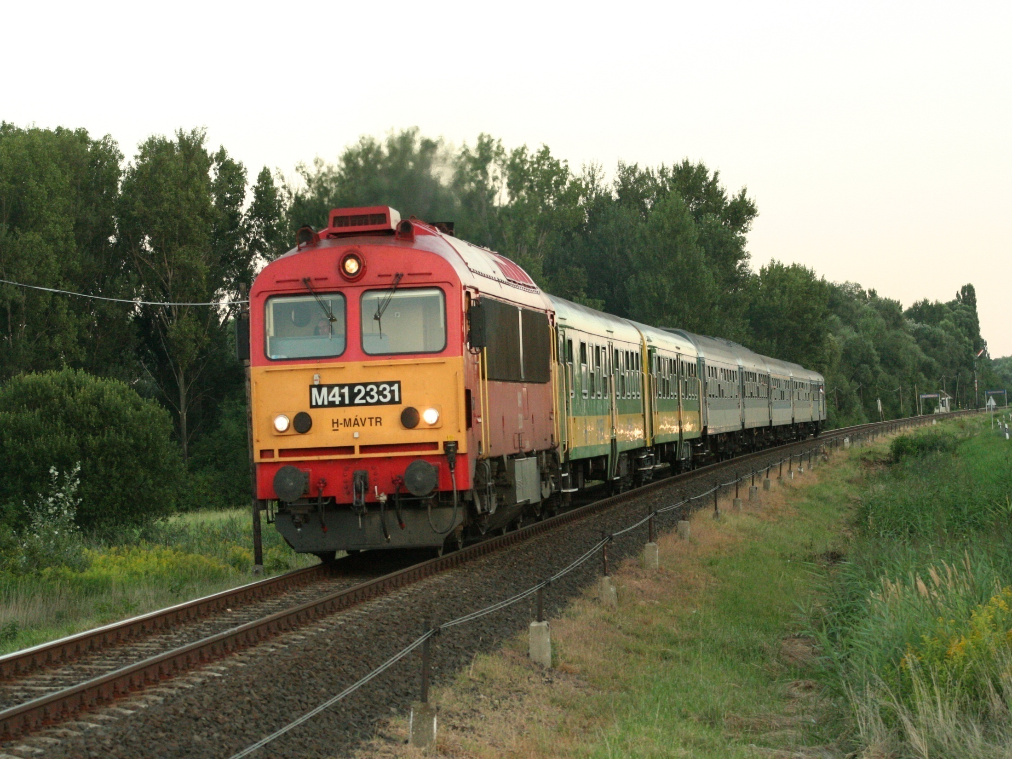
57. FIRAC Congress
04.-08.10.2018
HUNGARY
Tapolca

Slide 2
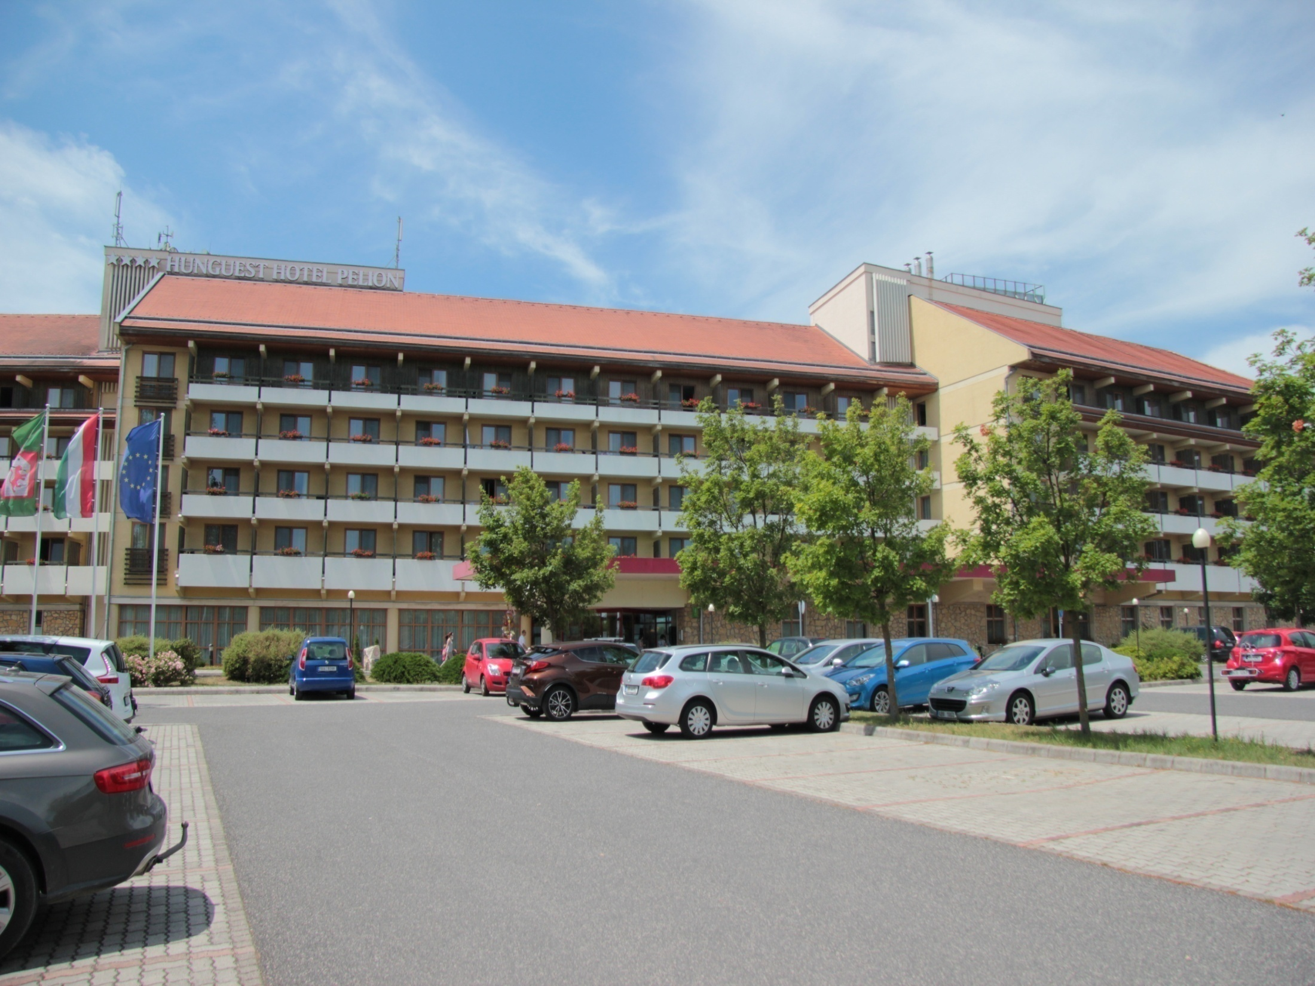
Hotel Pelion Tapolca
**** Superior Hotel
wellness and recreation part are free charge

Slide 3
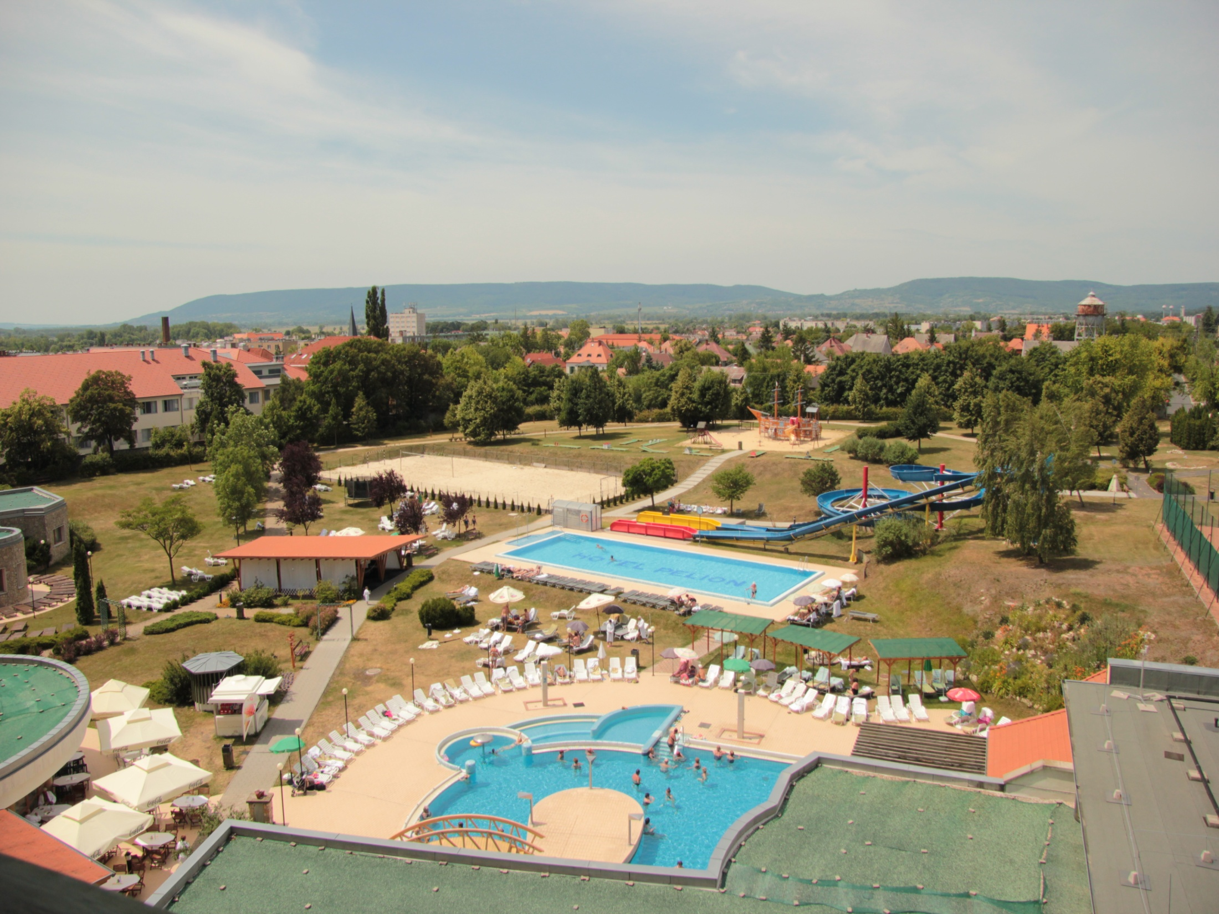
Hotel Pelion
Outside and inside pools
31-33 °C warm termal water
Under the hotel is a salt cave with clean and healthy air, where can be recreate

Slide 4
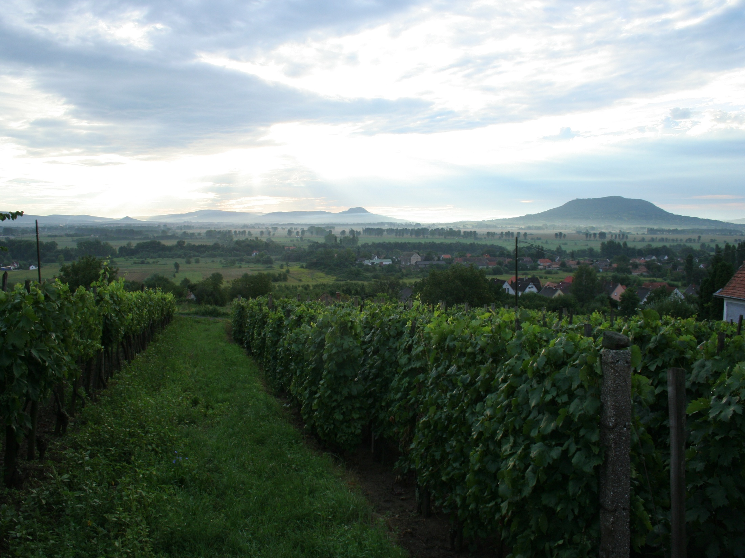
Around Tapolca
Big wine-growing region
There are many hill, where can be doing SOTA QSOs

Slide 5
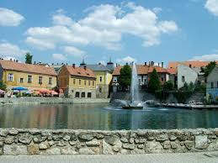
The Programe plan
27.09 Thursday
FIRAC Congress members arrive
Dinner
President meeting
28.09 Friday
Breakfeast
Opening the congress and radio station
Congress meeting
Lunch
City tour
Dinner
(alt.: Wellness)

Slide 6
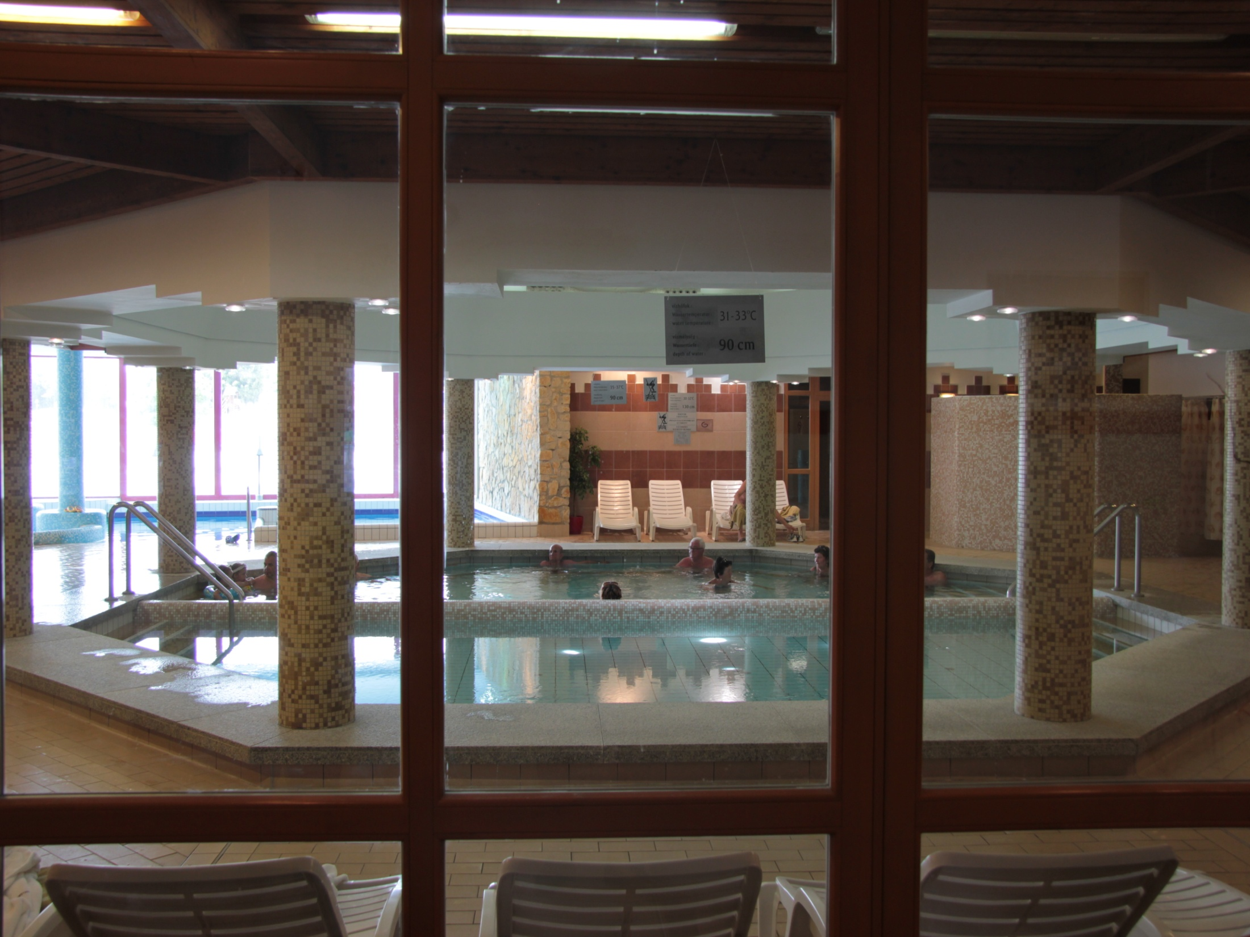
The Programe plan
29.09 Saturday (Wellness and recreation day)
Breakfeast
(Congress meeting)
Lunch
Free time ( We recommended the wellness and recreation part of hotel)
Dinner
Operett performance

Slide 7
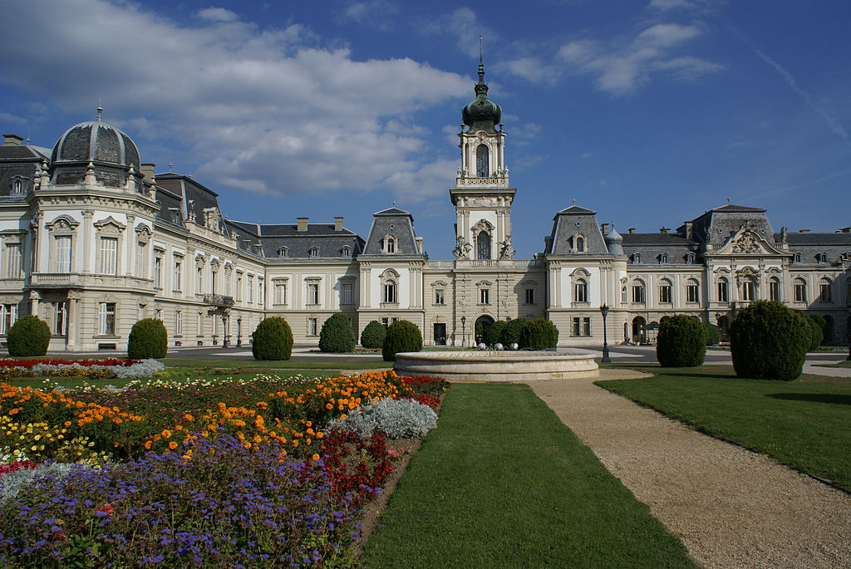
The Programe plan
30.09 Sunday
Breakfeast
Trip to Keszthely (look: Castle of Festetics, modelltrain exibition)
Trip to Badacsony
Dinner in hause of Kisfaludy
Vintage present and wine taste
Trip to hotel
Diner and Closeing ceremony
01.10 Monday
Breakfeast
Depart to home

Slide 8
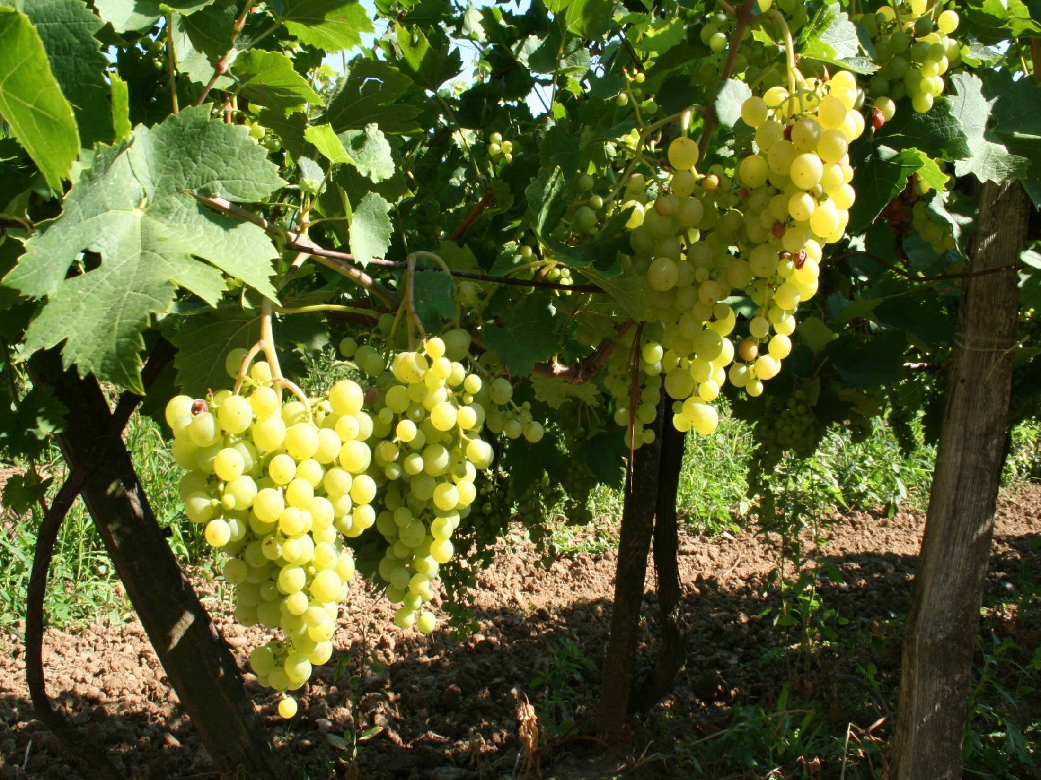
WE WELCOME EVERYONE

